Slide 1
Representation of a xodr-defined road in MATLAB struct
Wushuang Bai
20230418

Slide 2
The purpose of this presentation is to explain how a simple road defined in a xodr file is represented in a MATLAB struct.
The example in this presentation is a one lane, one way, no shoulder straight road. See https://github.com/ivsg-psu/PathPlanning_MapTools_ParseXODR/blob/main/Data/XODRExport/XODRExport/MATLAB/01CreatedInMATLAB/testXODR_23-03-21T15-02-19_100mLine_oneLane_noShoulder.xodr
Example MATLAB struct can be found here: https://github.com/ivsg-psu/PathPlanning_MapTools_ParseXODR/tree/main/Data/MatlabStructForTestingSimpleRoads

Slide 3
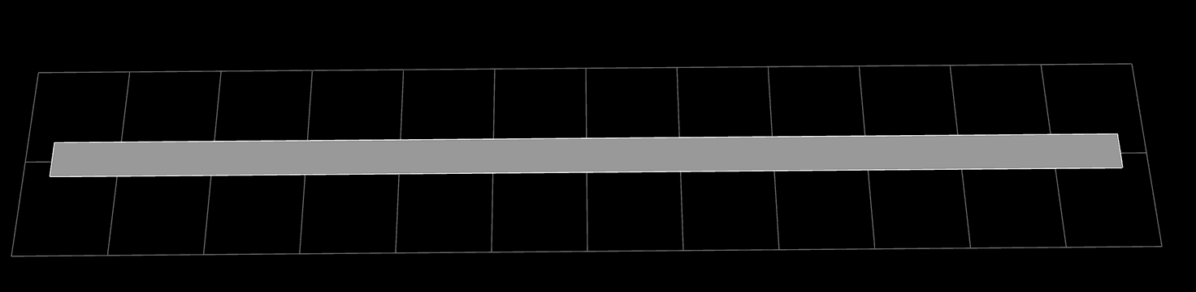
The example in this presentation is a one lane, one way, no shoulder straight road.

Slide 4
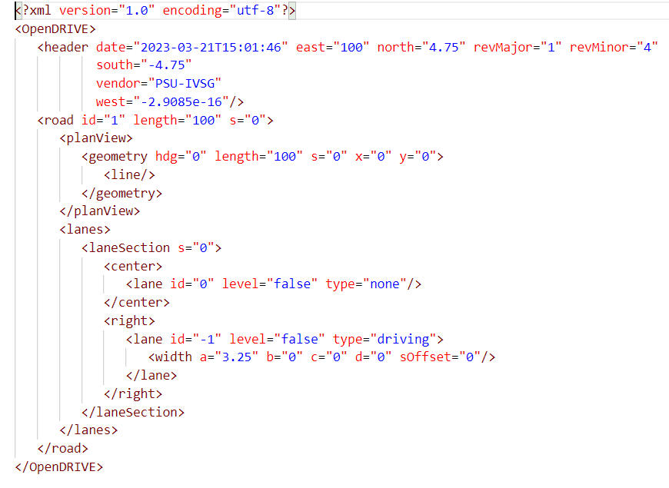
The entire file, wrapped by the lv1 element <OpenDRIVE>, is converted to a struct in MATLAB.
Xodr content
MATLAB representation

Slide 5
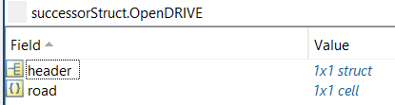
The lv2 elements are <header> and <road>, where <header> is a struct, and <road> is a cell.
Xodr content
MATLAB representation

Slide 6

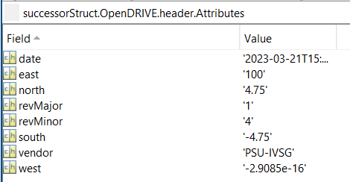
The contents in <header> are represented by a “Attributes” struct in MATLAB
Xodr content
MATLAB representation

Slide 7

As stated in slide 5, <road> is described as cell in MATLAB, and each cell element is a struct.
Xodr content
MATLAB representation

Slide 8
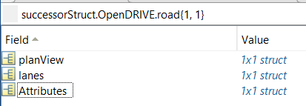
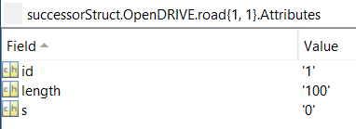
The attributes of <road>,i.e., id, length, s, are represented by a “Attributes” struct in MATLAB.
Xodr content
MATLAB representation

Slide 9
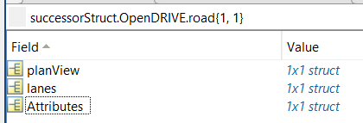
Lv3 elements under <road>, aka <planView> and <lanes>, are described as struct in MATLAB.
MATLAB representation
Xodr content

Slide 10
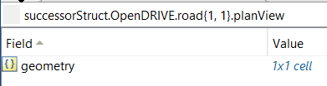

<planView> contains <geometry>, which is a cell in MATLAB. Each of the cell element is a struct.
Xodr content
MATLAB representation

Slide 11
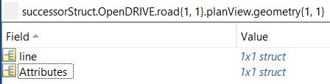
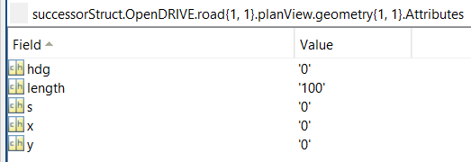
The attributes of <geometry>, aka hdg, length, s, x and y are contained in a “Attributes” struct.
Xodr content
MATLAB representation

Slide 12
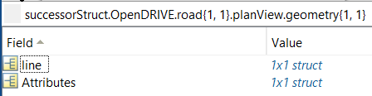
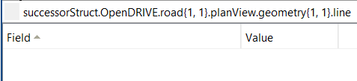
The <line> under <geometry> is an empty struct in MATLAB.
Xodr content
MATLAB representation

Slide 13
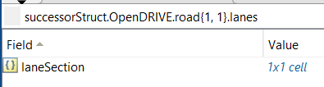
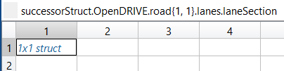
<lanes> contains <laneSection> as cell in MATLAB, and each cell element is a struct.
Xodr content
MATLAB representation

Slide 14
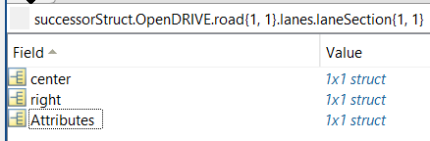
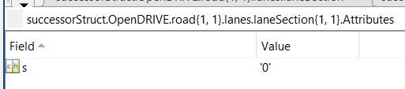
Attributes of <laneSection> are a struct “Attributes” in MATLAB.
Xodr content
MATLAB representation

Slide 15
<center> and <right> are struct in MATLAB.
Xodr content
MATLAB representation

Slide 16
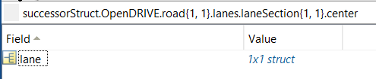
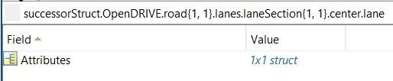
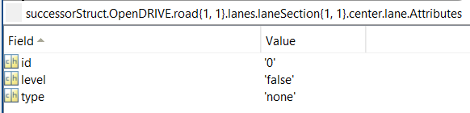
The <lane> under <center> is a struct. And the attributes of <lane> are a “Attributes” struct in MATLAB.
Xodr content
MATLAB representation

Slide 17
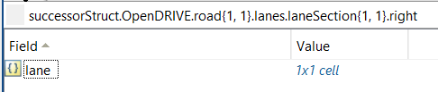

<right> is a struct in MATLAB, which contains cells. And each cell element is a struct.
MATLAB representation
Xodr content

Slide 18
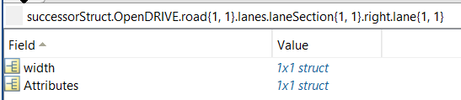
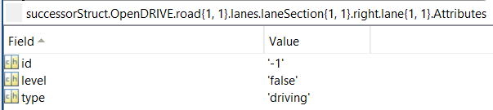
The attributes for <lane> are described as a “Attributes” struct.
MATLAB representation
Xodr content

Slide 19
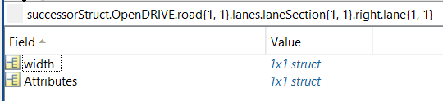
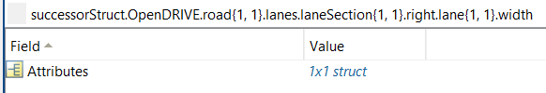
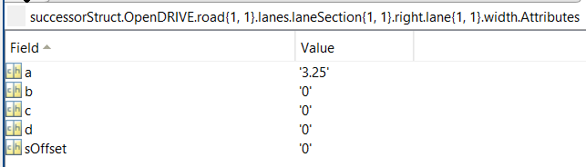
The <width> under <lane> is a struct, with attributes described as “Attributes” struct in the next level.
Xodr content
MATLAB representation

Slide 20
Conclusion of the manner how xodr is represented in MATLAB is below.
A xodr is represented as a struct in MATLAB
A child element to its parent element, such as <header> to <OpenDRIVE>, is a child struct to this struct
Fields (attributes) next to an element, such as “id” to <road>, is described as a “Attributes” struct
The “Attributes” of an element is at the same level with the child elements of this element. For example, “Attributes”, <planView> and <lanes> are all child struct to <road>, see slide 8.
If an element is possible to have repetitions (but different contents), it may be described as cells in MATLAB. For example, <road> is cells in MATLAB, since we may have several roads under <OpenDRIVE>. Also, <laneSection> is cells in MATLAB, since we may have several lane sections under one <road>.

